Slide 1
Handy balloon hunter
Computer vision python game
By: shifa khousain

Slide 2
Abstraction
My project is basically based on computer vision and augmented reality, where I have connected my laptop’s camera to a python program using OpenCV and CVZone package.
The very next thing is to create a game environment window and to do that python got me with libraries such as pygame.
In order to add some functionality into the game there is an image and score booth.
The functionality also includes hand detection and to do that I have included some packages like mediapipe.
Let’s talk about how actually my project works
So basically it’s a complete computer vision game where you have to pop balloon with your hand gesture in the form of AR.
The program is set in such a way that the balloon is moved randomly on the screen and the speed of the balloon keeps incrementing which gives out a great experience to the player.
The scores are set by counting the number of balloons being popped in a particular given time span.

Slide 3
CV
Knowing more about COMPUTER VISION

Slide 4
“Predicting the future isn't magic, its artificial intelligence ”

Slide 5
Pygame
01

Slide 6
Introduction
In the dynamic realm of computer vision and augmented reality, where technology converges with interactive entertainment, this project present an innovative and captivating project that pushes the boundaries of gaming and immersion, this project seamlessly combines the power of computer vision with the magic of augmented reality to deliver a unique gaming experience.
Imagine a world where your laptop’s camera becomes the gateway to an exciting game environment that comes to life on your screen. This project harnesses the capabilities of open cv and cv zone to connect your camera to a python program, setting the stage for an extraordinary gaming adventure.
The journey into this immersive world doesn’t stop there. The project leverage the versatile pygame library to create a virtual gaming environment that captivates players from the moment they enter. Within this virtual world, players are presented with an exciting challenge: to pop balloons using hand gestures, all within the realm of augmented reality.

Slide 7
Introduction
The mechanics of the game are a testament to the power of computer vision. Balloons float freely around the screen, driven by randomness and a touch of unpredictability. As you immerse yourself in this balloon-popping frenzy, the speed of these elusive targets increases progressively, demanding your utmost focus and agility.
But it’s not just about popping balloons; it’s also about achieving high scores and bragging rights. The game dynamically counts your successes, tracking the number of balloons popped within a specified time frame. Each balloon you bust adds to your score, fueling your competitive spirit and encouraging you to outdo yourself.
My project represents more than just a computer vision experiment. It’s a fusion of technology and entertainment, where the real and virtual seamlessly intertwine. It challenges you to test your dexterity, sharpen your hand detection skill using packages like Mediapipe, and embark on an exciting journey into argument reality gaming.
Prepare to be captivated by the world of AR gaming, where your hand gestures and quick reflexes will determine reality, and computer vision converges to redefine the gaming experience. This is more than a project; it’s an invitation to explore the future of immersive entertainment. Welcome to the world of computer vision, augmented reality, and balloon-pooping fun.

Slide 8
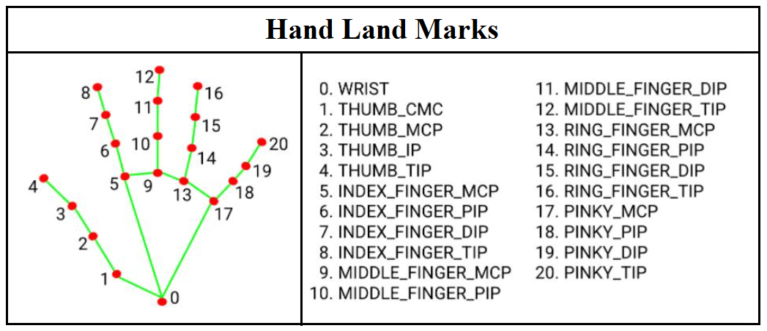
Understanding hand detection

Slide 9

Objective
1. Entertainment and engagement:
· Create an enjoyable and engaging game that provides entertainment and relaxation for players.
2. educational value:
· Incorporate educational elements in to the game to teach players about
Computer vision technology, hand detection, or other related concepts in a fun and interactive way.
3. skill development:
· Help players improve their hand –eye coordination, reflexes, and cognitive skills through game play.

Slide 10
Objective
4. user interaction:
· Develop an interactive user interface that allows players to control the Game using hand gestures or other innovative input methods, demonstrating the capabilities of computer vision.
5. Technology showcase:
· Showcase the capabilities of computer vision and how it can be applied to create immersive and innovative gaming experiences.
Research and Experimentation:
· Use the project as an opportunity to experiment with computer vision algorithms, machine learning techniques, or other technical aspects, and gather data for research purposes.

Slide 11
REQUIREMENTS
HARDWARE REQUIREMENTS
LAPTOP/PC
CAMERA
Software requirement
Visual C++ Redistributable
DirectX End-User Runtime

Slide 12
LIBRARY REQUIREMENTS
PYCHARM
PYGAME
CV ZONE
OPENCV
MEDIAPIPE
NUMPY

Slide 13
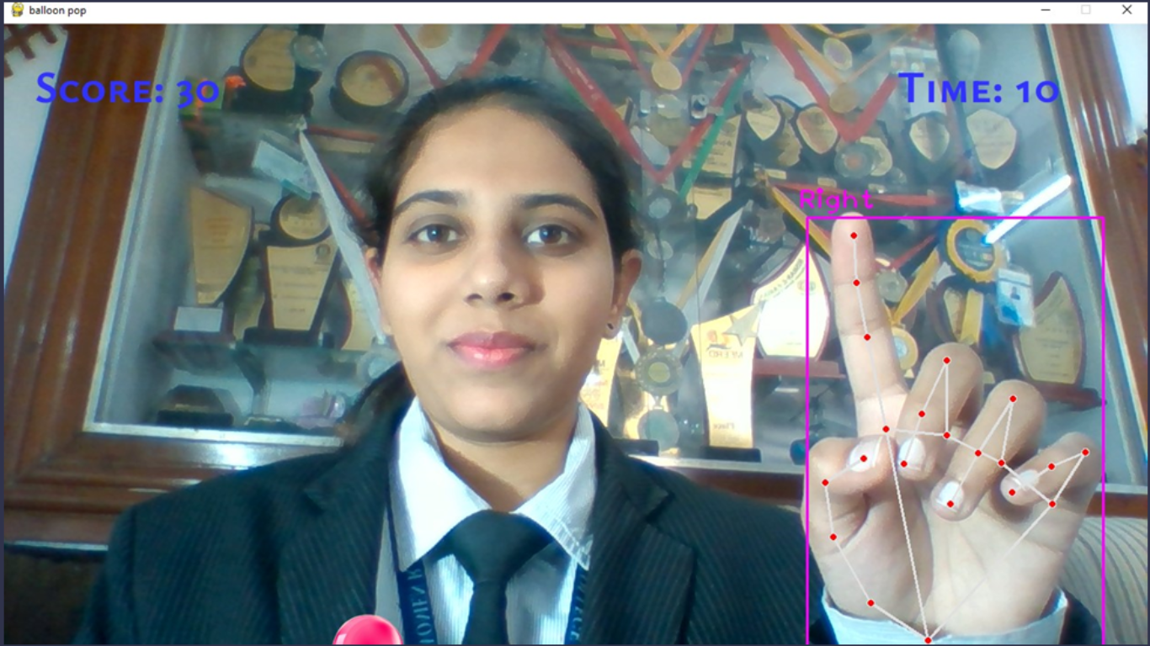
OUTPUT

Slide 14
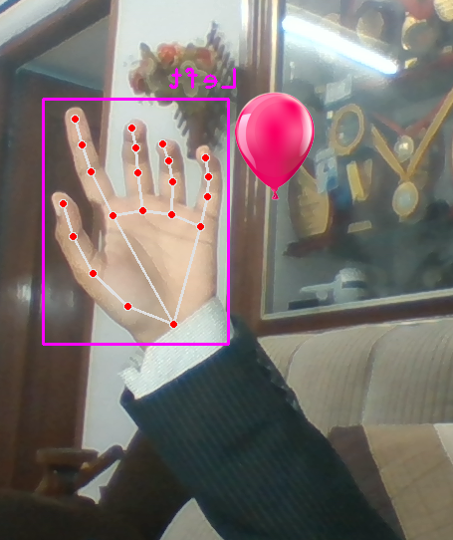
HAND DETECTION
USING MEDIAPIPE

Slide 15
"Unlock the magic of computer vision and Python gaming as we embark on a journey to detect balloons and pop them with the wave of your hand—because in this digital realm, fun knows no bounds! 🎈✨

Slide 16
THANKS!
FOR YOUR TIME.

